Slide 1
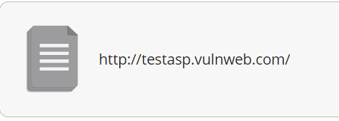

Slide 2
Site Details
System info
IP addresses
3.126.110.1
Hosting
Amazon AWS
Server
Microsoft-IIS 8.5
Language
ASP.NET
Links found
/Templatize.asp?item=html/about.html
/Default.asp
/Search.asp
/Login.asp?RetURL=/Default.asp?
/Register.asp?RetURL=/Default.asp?
/showforum.asp?id=0
/showforum.asp?id=1
/showforum.asp?id=2
Javascripts included
No JavaScript files found.
Iframes included
No iframes found.
Embedded objects included
No plugins found.

Slide 3
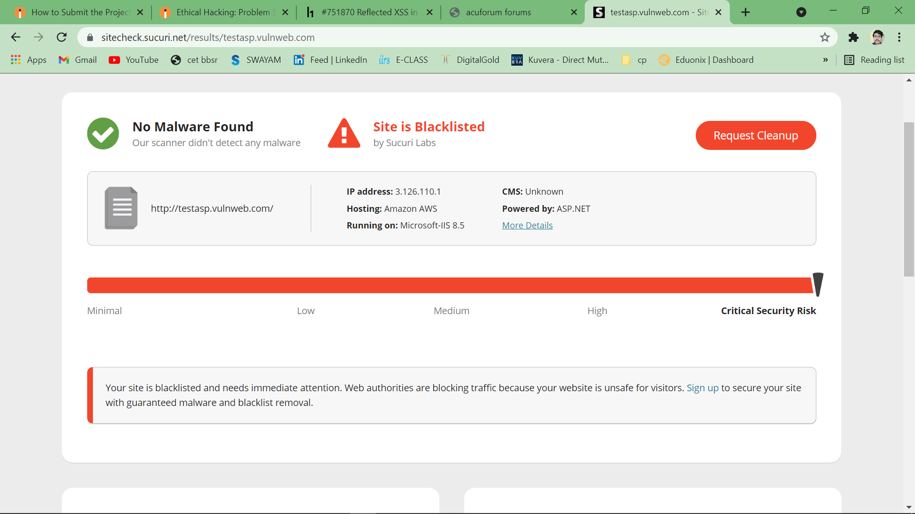

Slide 4
